Slide 1
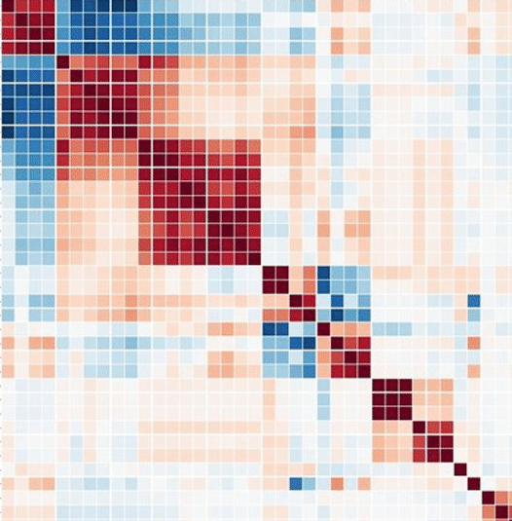
pyspi: python toolkit for statistical analysis of pairwise interactions
Package author: Oliver Cliff
Workshop presenter: Annie G. Bryant
16 July 2022
Gonna turn this into a cool graphic
Link to repo
QR code to repo
Notes:
Okay, so we have heard about two tools for highly comparative analysis of univariate time-series, and now we're going to switch gears a bit and take things to the next dimension with pairwise time-series analysis.

Slide 2
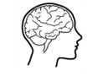
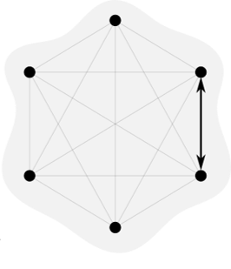
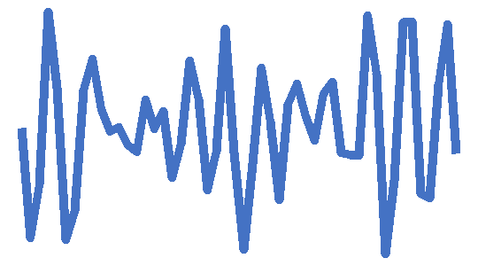
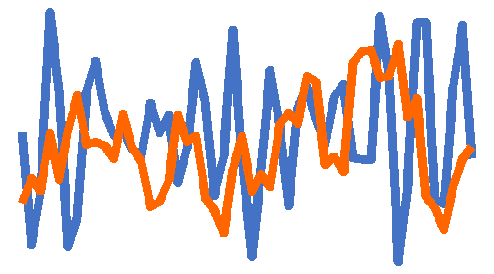
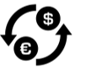
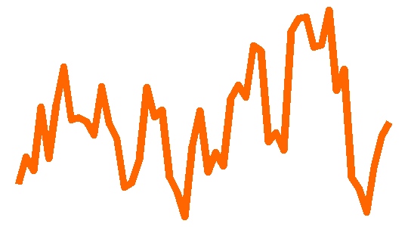
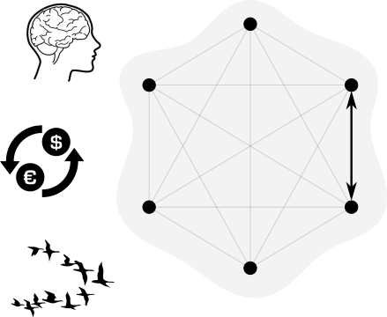
What are pairwise interactions?
Features that capture the relationship between the two nodes’ time-series
Pairwise interactions are studied across disciplines
Neuroscience: Connectivity measures
Econometrics: Interactions between assets
Biology: Leader/follower in collective motion
Slide adapted courtesy of Oliver Cliff

Slide 3
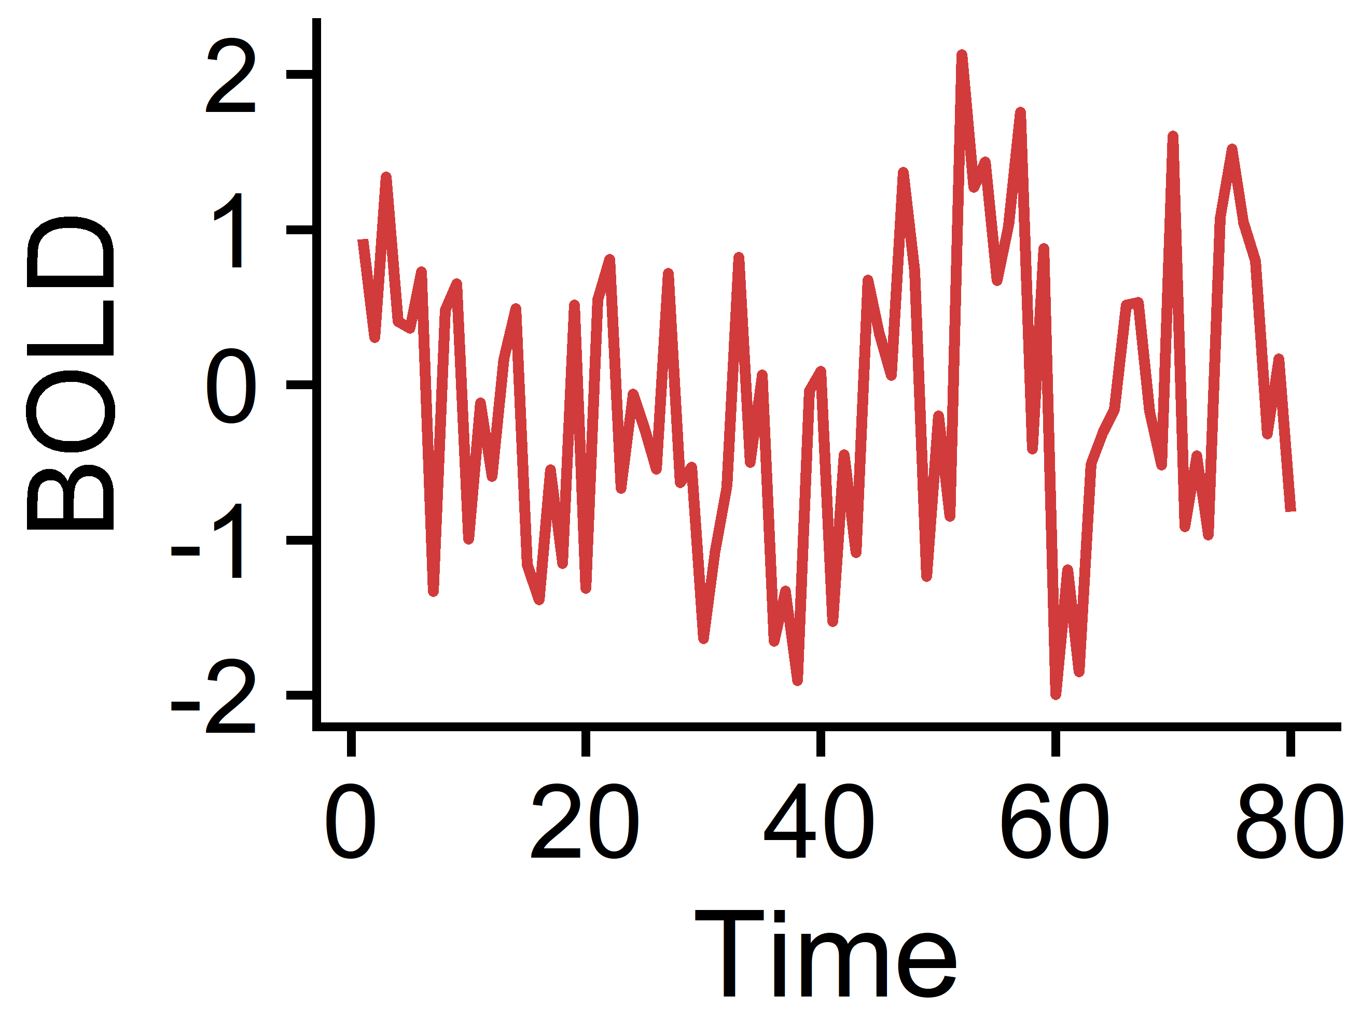
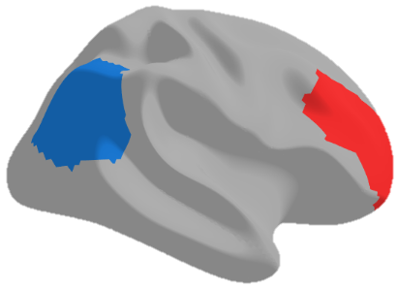
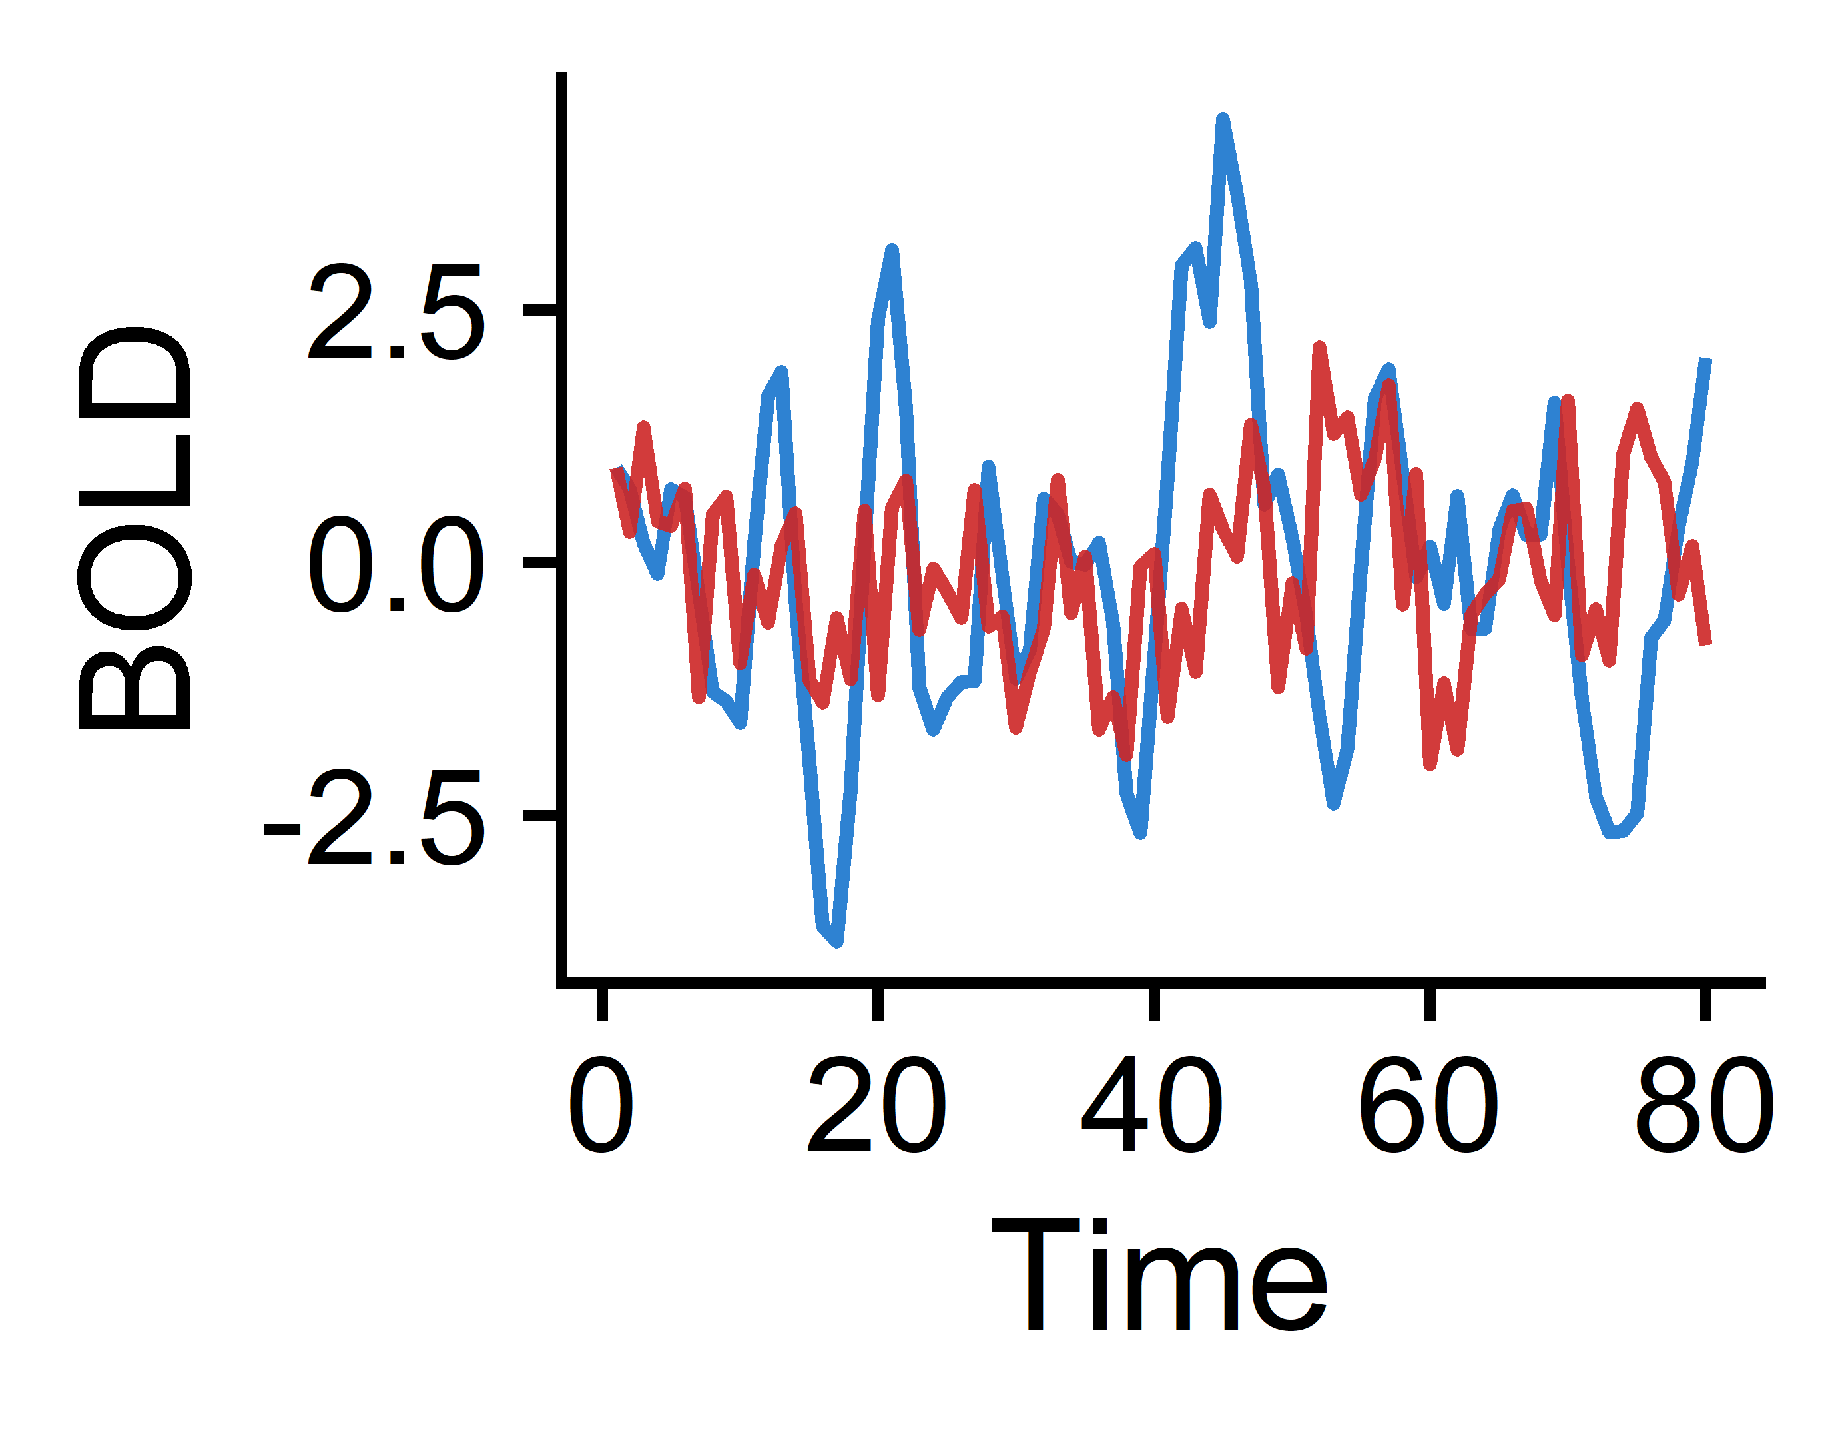
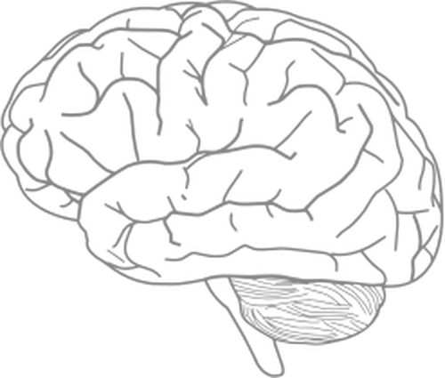
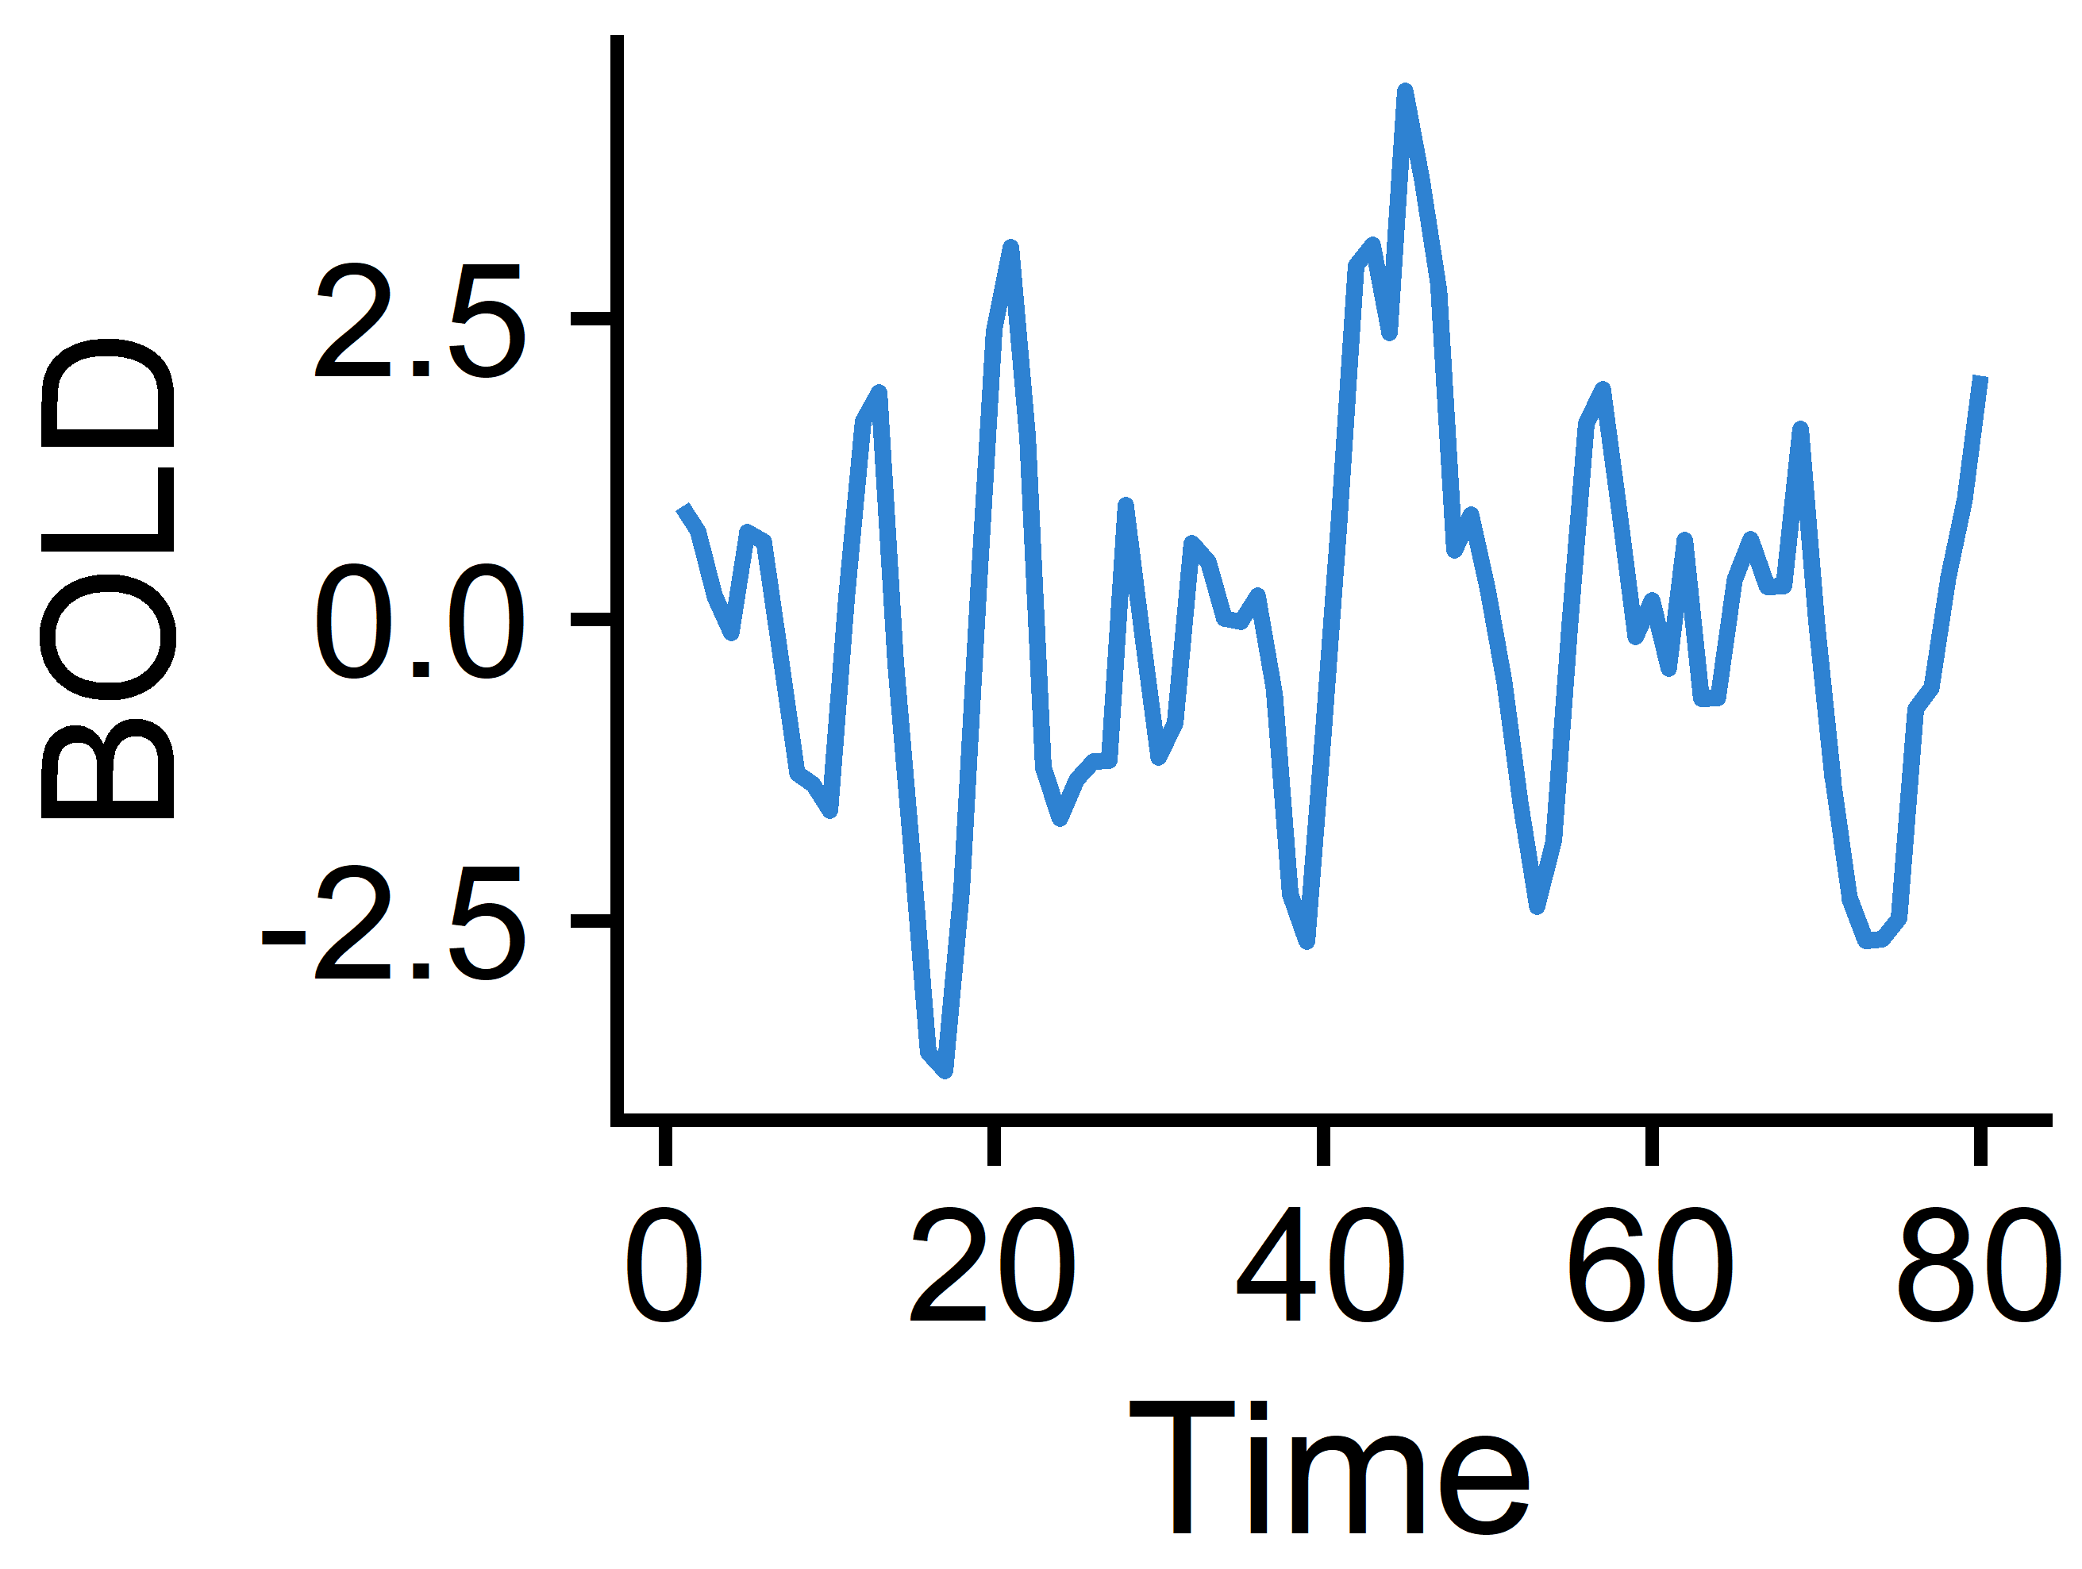
How are pairwise interactions typically explored in computational neuroscience?
Region 2
Region 1
Multivariate time-series
Calculate Pearson correlation coefficient (PCC) between two regions’ time-series
Combine PCCs across all region pairs to construct a functional connectivity (FC) matrix
Regional BOLD fMRI signals

Slide 4
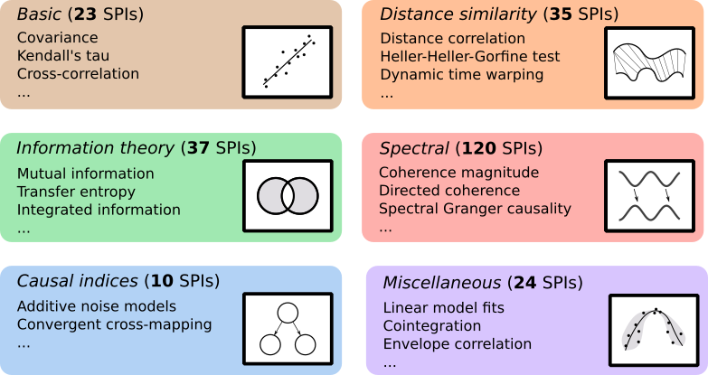
What else is out there?
pyspi
Pearson correlation
Pearson correlation
Pearson correlation
Comprehensive library of 249 statistical pairwise interactions derived from multiple disciplines of research
Cliff et al. 2022 (arXiv)

Slide 5
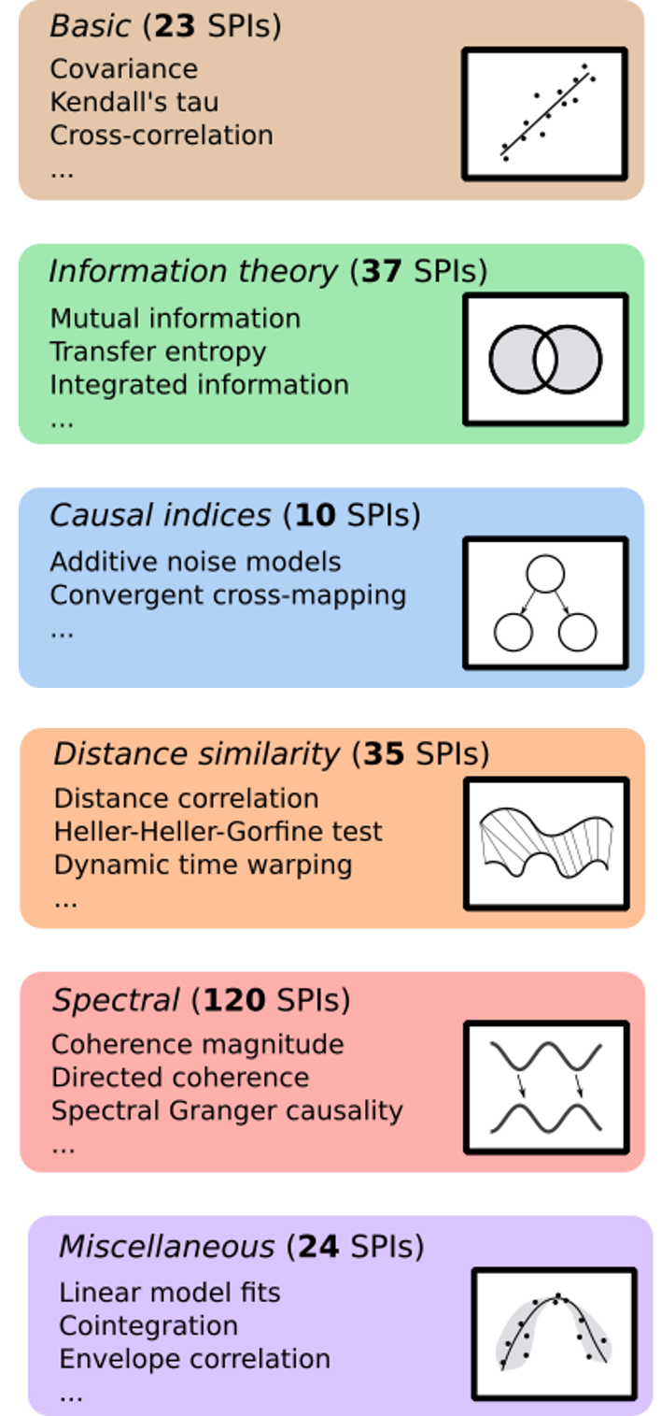
I pyspi with my little eye-spi…
… an open-source python package for highly comparative multivariate time-series analysis!
Time points
SPIs 1-249
Choose which SPIs to calculate
Run pySPI with Calculator.compute()
Processes (e.g. brain regions)
Processes
(default is all 249)
Processes
Input: a tabular dataset of processes by time points
Input: a tabular dataset of processes by time points
Output: a set of tabular datasets containing pairwise values for each pair of processes by SPI
https://github.com/olivercliff/pyspi

Slide 6
How can pyspi revolutionize how we look at functional connectivity in the human brain?
Region 2
Region 1
Calculate Pearson correlation coefficient (PCC) between two regions’ time-series
Combine PCCs across all region pairs to construct a functional connectivity (FC) matrix
Multivariate time-series
Regional BOLD fMRI signals
Calculate 248 other SPIs that capture distinct relationships between two brain regions’ activities
Examine many diverse types of FC in the brain in health and disease

Slide 7
Let’s get pySPI running!
Key links
https://github.com/olivercliff/pyspi
https://pyspi-toolkit.readthedocs.io/en/latest/
https://wiki.octave.org/Category:Installation
https://www.anaconda.com/products/distribution
Quick steps to install
[OPTIONAL] install octave on your machine from above link
[OPTIONAL] create a specific conda environment for pySPI
conda create –n pyspi python=3.9.0
conda activate pyspi
Clone the pySPI github repo to your machine
e.g. git clone https://github.com/olivercliff/pyspi.git
Navigate to downloaded repo
e.g. cd ~/pySPI
python3 –m pip install .

Slide 8
How we’re making pyspi more accessible
pyspi-distribute
Interface with R via reticulate() package

Slide 9


Applying pyspi to BOLD fMRI time-series data
Tutorial data: one participant from the UCLA Consortium for Neuropsychiatric Phenomics LA5c Study¹
Data is split up into 4 sets of 4 brain regions, each of which has 152 time points (fMRI frames)
We will go through:
Preparing our multivariate time-series data to be in the right format
Visualizing the raw time-series data
Running pyspi on our four datasets
Extracting the resulting SPIs and combining them across the 4 sets
Visualizing our SPI output
More in-depth tutorial: https://github.com/olivercliff/pyspi/blob/main/demos/tutorial.ipynb
¹Gorgolewski KJ et al. A Preprocessed consortium for Neuropsychiatric Phenomics dataset. (2017).

Slide 10



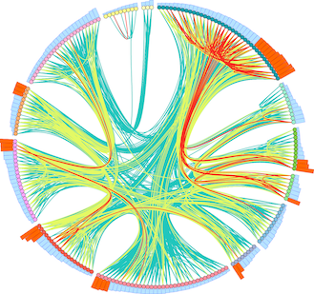

Thank you! Any questions?
Oliver M. Cliff
pyspi author
https://github.com/olivercliff
With support from:
The University of Sydney Physics Foundation
Ben D. Fulcher
Supervisor
Dynamics and Neural Systems Lab
School of Physics
The University of Sydney
The American Australian Association Graduate Education Fund

